Slide 1
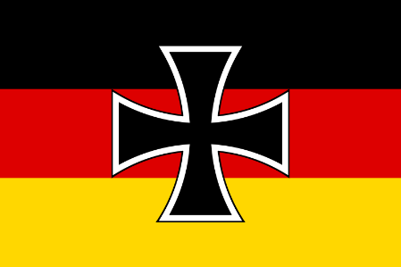
Challenges to the Weimar Republic
The Kapp Putsch
The 1923 crises
Occupation of the Ruhr
Economic collapse and hyperinflation
Munich (Beer Hall) Putsch

Slide 2
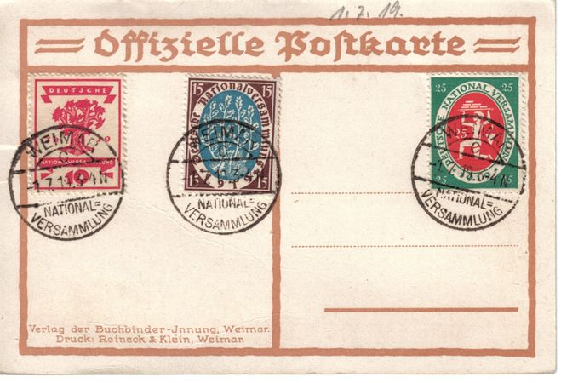
Official postcard of the National Assembly

Slide 3
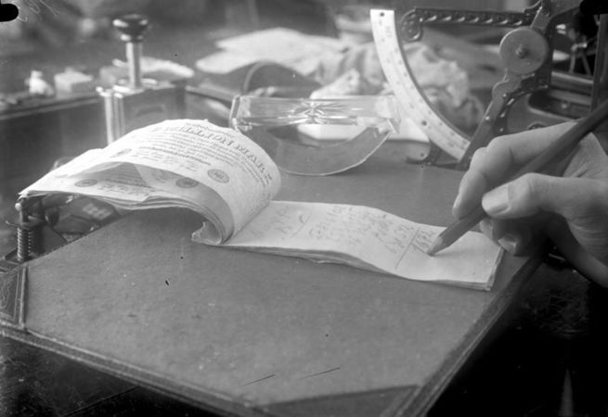
One-million mark notes used as notepaper, October 1923

Slide 4
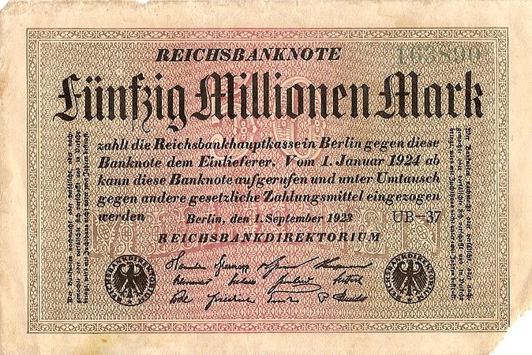
50-million mark banknote issued in 1923, worth approximately one US dollar when issued. Nine years earlier, 50 million marks would have been worth approximately 12 million US dollars. Within a few weeks, inflation made the banknote practically worthless

Slide 5
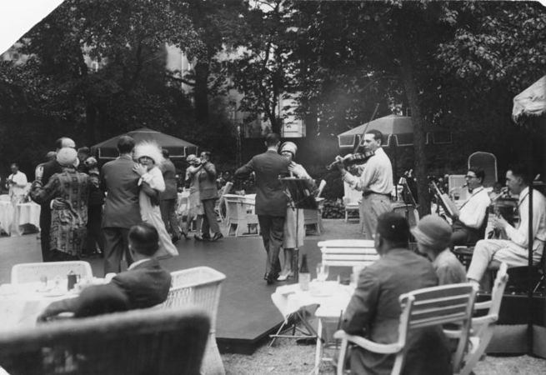
The "Golden Twenties" in Berlin: a jazz band plays for a tea dance at the hotel Esplanade, 1926

Slide 6
The story so far…
Pre-1914
1914-1918
November 1918-June 1919
June 1919

Slide 7
Problems in Weimar Germany
https://www.youtube.com/watch?v=6PPeszzSQvo
What were the main issues of the Weimar Republic and what impact did this have on Germany?
Write a 1 sentence response.

Slide 8
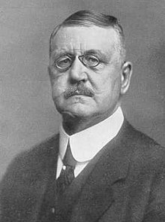
The Kapp Putsch
https://www.youtube.com/watch?v=E1jggIpv8Mg
The threat from the Right
In crushing the communists (The Spartacist Uprising) the Freikorps had saved the government, but the terms of the Treaty of Versailles meant Germany’s army had to be significantly reduced and the Freikorps had to be disbanded.
During 13 - 17 March 1920, as a reaction to this, the right-wing nationalist, Dr Wolfgang Kapp led a Freikorps takeover in Berlin.
The regular army refused to attack the Freikorps; Kapp was only defeated when the workers of Berlin went on strike and refused to cooperate with him.

Slide 9
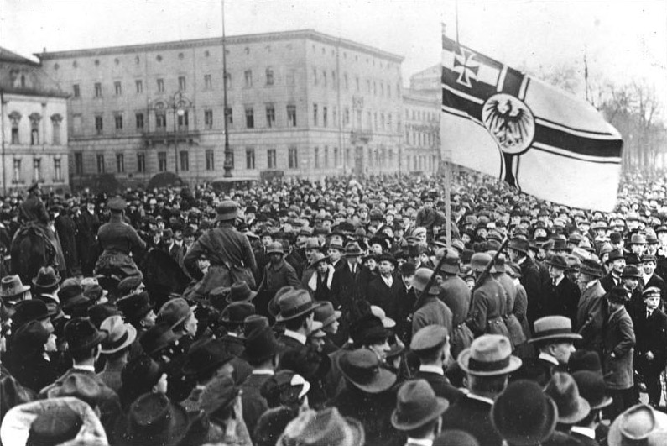
What would have happened if the Kapp Putsch was successful? (1 sentence answer)

Slide 10
1923 Crises: Occupation of the Ruhr
French and Belgian occupation of the Ruhr
In November 1922 Germany defaulted on its reparations payment as scheduled. The first reparations payment had taken all she could afford to pay.
In response, France and Belgium sent troops into Germany’s main industrial area, the Ruhr Valley. They occupied coal mines, railways, steel works and factories – all things that were important to Germany’s economy.
The German government ordered workers to follow a policy of ‘passive resistance’ – refusing to work or co-operate with the foreign troops and in return the government continued to pay their wages.
The French responded firmly – in the Krupp steel works, workers refusing to take orders were shot at. Overall, 132 were killed and approximately 150,000 expelled from the area.
The immediate consequences of the occupation were not good for the Weimar government – they decided to print more money to pay the workers in the region, contributing to hyperinflation. A general strike (when all the workers in the country stopped work) was called, and political instability was rife.

Slide 11
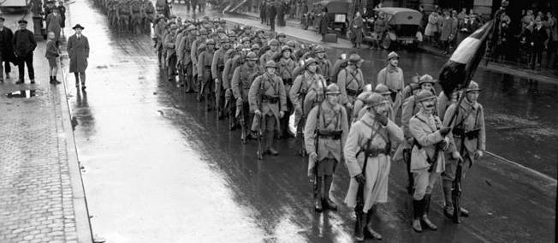
What did the French and Belgium occupations of the Ruhr aim to achieve? (1 sentence answer)

Slide 12
1923 Crises: Economic collapse and hyperinflation
Germany was already suffering from high levels of inflation due to the effects of the war and the Treaty of Versailles.
‘Passive resistance’ meant that whilst the workers were on strike fewer industrial goods were being produced, which weakened the economy still further.
In order to pay the striking workers the government simply printed more money. This flood of money led to hyperinflation as the more money was printed, the more prices rose.
Prices ran out of control, for example a loaf of bread, which cost 250 marks in January 1923, had risen to 200,000 million marks in November 1923.
By autumn 1923 it cost more to print a note than the note was worth.
During the crisis, workers were often paid twice per day because prices rose so fast their wages were virtually worthless by lunchtime.

Slide 13
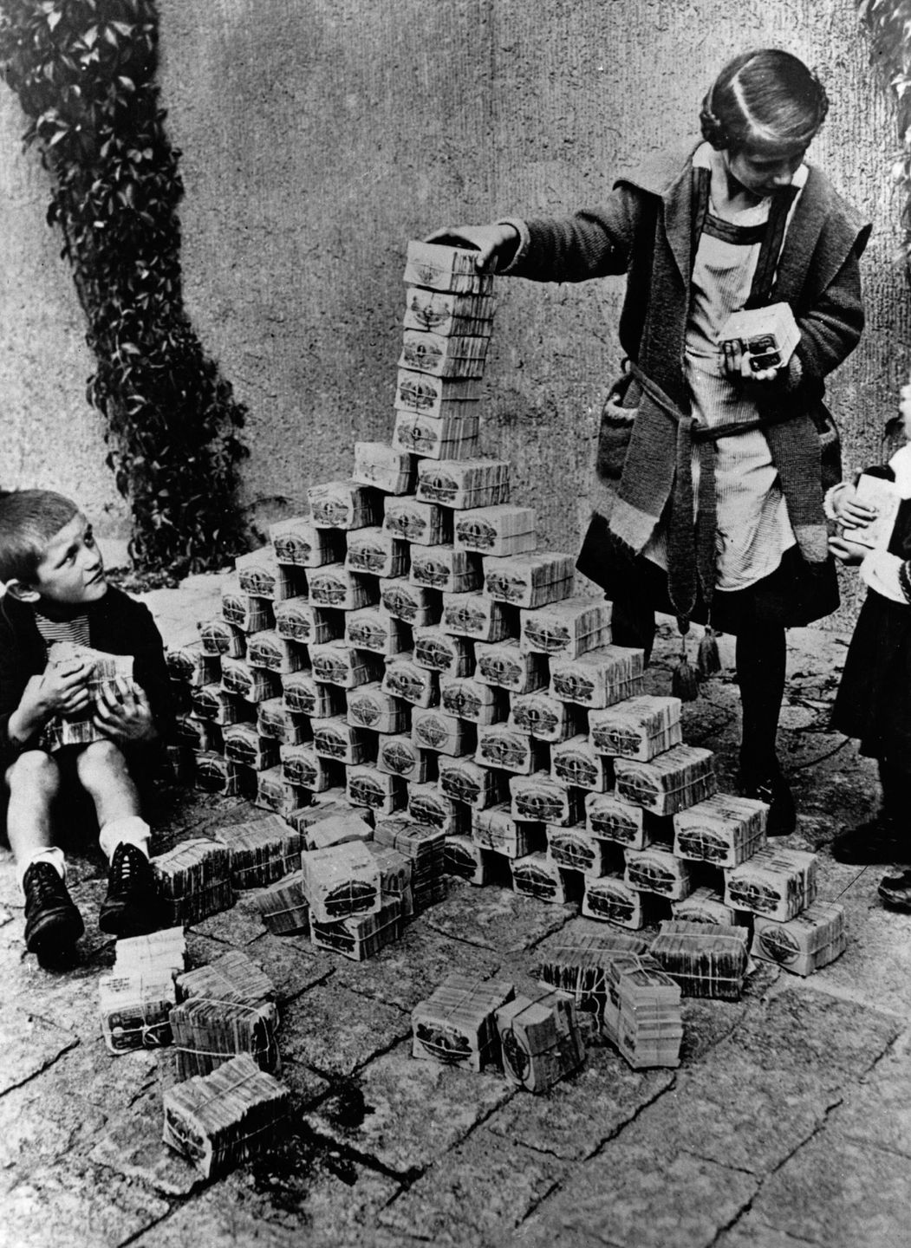
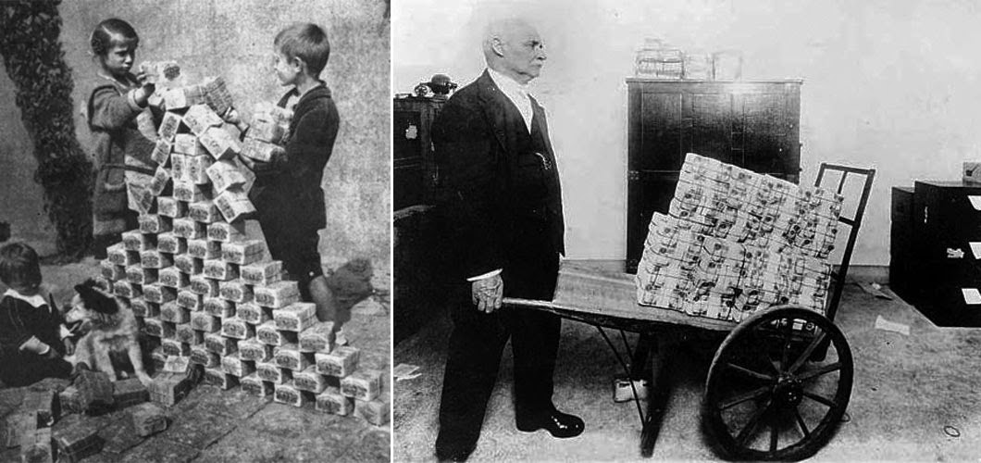
What impact did hyperinflation have on Germany? (Hint: Weimar Republic) (1 sentence answer)

Slide 14
1923 Crises: The Munich (Beer Hall) Putsch
https://www.youtube.com/watch?v=mTFerHrvm18
On November 8–9, 1923, Adolf Hitler and the Nazi Party led a coalition group in an attempt to overthrow the German government. This attempted coup d'état came to be known as the Beer Hall Putsch.
A failed takeover of the government in Bavaria.
Since 1921, Hitler had led the Nazi Party
In the aftermath of the failed “putsch,” or coup d’état, Hitler was convicted of treason and sentenced to five years in prison. He spent less than a year behind bars, during which time he dictated “Mein Kampf,” his political autobiography.

Slide 15
How successful was the Munich Putsch?
Source A
It was at this point that Hitler seemed to snatch some kind of victory out of the jaws of defeat. The trial gave him a national platform on which to speak…Newspapers throughout Germany and around the world reported his claim that he had led the movement against the ‘treasonable’ Weimar system…
Lacey and Shephard, 1997.

Slide 16
How successful was the Munich Putsch?
Source B
The court was also sympathetic to Hitler. Instead of sentencing him to death as it might have done, it gave him the minimum sentence for the offence – five years imprisonment. The judges also made it clear that he could expect an early release. In fact, Hitler served just nine months of his sentence…He spent much of the time dictating the first part of his book, Mein Kampf (‘My Struggle’). Imprisonment provided Hitler with a period of enforced leisure in which he was able to sort out his main ideas.
Stephen Lee, 1996.

Slide 17
What do the statements say about the Munich Beer Hall Putsch – success or failure?
Hitler was mistaken in his support from the army and police. | Hitler got much public support during his Munich march. | Hitler served out his sentence in a comfortable jail
Many Nazi supporters got light sentences. | Hitler’s time in prison allowed him to write Mein Kampf | Hitler changed his strategy to winning power to legal means.
Opposition within the Nazi Party melted. | Hitler was mistaken in his support from the Bavarian government. | Hitler’s trial made him into a national figure.
The Nazis did not have enough weapons to attempt a strong coup. | The Putsch failed and 16 Nazis were killed. | The Bavarian leaders were set free and betrayed Hitler.

Slide 18
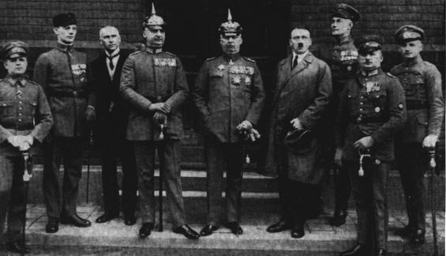
What was the impact of the Munich Beer Hall Putsch? Think of short-term effects and long-term effects. (1 sentence answer)

Slide 19
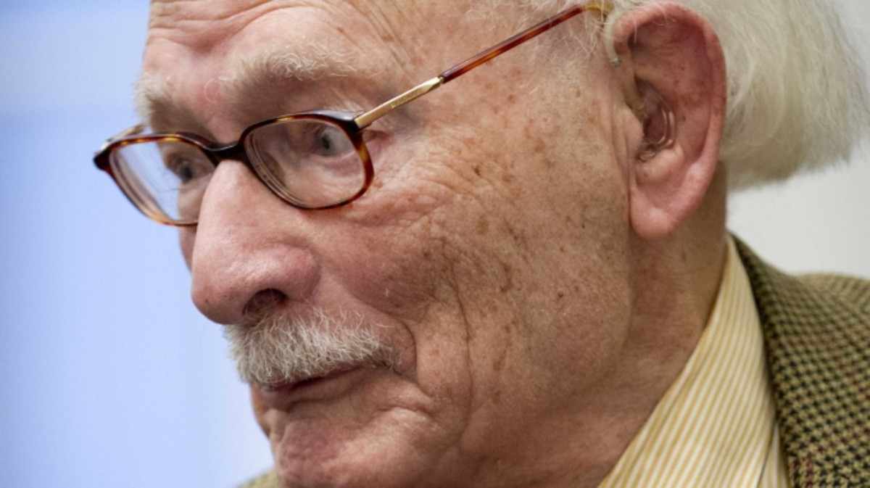
History hero
Teacher, Johan van Hulst, Saved Hundreds of Jewish Children
In 1942 and 1943, Dutch educator Johan van Hulst arranged for the transport of some very precious cargo. It was passed over a hedge, hidden in basket and sacks, and then whisked out of Amsterdam by bicycle. The cargo wasn’t food or supplies: It was Jewish children, smuggled and saved by van Hulst and his colleagues during the Nazi occupation of the Netherlands.

Slide 20
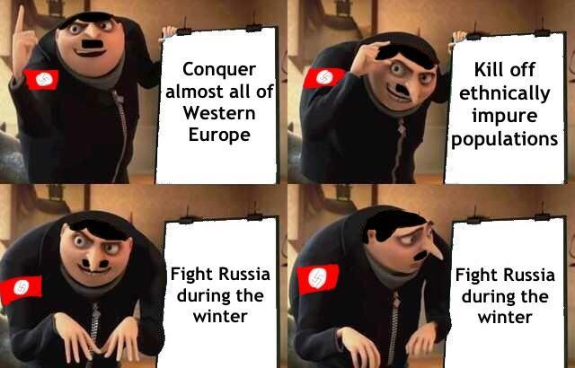
History Heroes Week 1, Term 3

Slide 21
When did Germany agree to an armistice following WW1?
a. 3 November 1918
b. 9 November 1918
c. 11 November 1918

Slide 22
Which of the following features of the Weimar constitution was considered to be a strength?
a. Article 48
b. Bill of Rights
c. Proportional representation

Slide 23
What nickname was often given to those German politicians who negotiated the armistice at the end of World War One?
a. Freikorps
b. November Criminals
c. Spartacists

Slide 24
What did Article 231 of the Treaty of Versailles say?
a. Germany had to pay reparations to the Allies
b. Germany had to accept blame for starting the war
c. Germany had to give up its overseas colonies

Slide 25
When did France and Belgium occupy the Ruhr industrial area of Germany in response to the non-payment of reparations?
a. May 1921
b. November 1922
c. January 1923

Slide 26
What was the name of the new currency introduced in October 1923 that helped to end hyperinflation?
a. Papiermark
b. Rentenmark
c. Deutsche Mark

Slide 27
What was the name of the repayment plan agreed for Germany's reparations in September 1924?
a. Dawes Plan
b. Young Plan
c. Marshall Plan

Slide 28
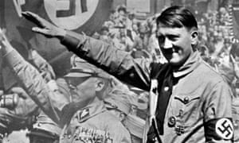
ANSWERS
Nein

Slide 29
When did Germany agree to an armistice?
a. 3 November 1918
b. 9 November 1918
c. 11 November 1918

Slide 30
Which of the following features of the Weimar constitution was considered to be a strength?
a. Article 48
b. Bill of Rights
c. Proportional representation

Slide 31
What nickname was often given to those German politicians who negotiated the armistice at the end of World War One?
a. Freikorps
b. November Criminals
c. Spartacists

Slide 32
What did Article 231 of the Treaty of Versailles say?
a. Germany had to pay reparations to the Allies
b. Germany had to accept blame for starting the war
c. Germany had to give up its overseas colonies

Slide 33
When did France and Belgium occupy the Ruhr industrial area of Germany in response to the non-payment of reparations?
a. May 1921
b. November 1922
c. January 1923

Slide 34
What was the name of the new currency introduced in October 1923 that helped to end hyperinflation?
a. Papiermark
b. Rentenmark
c. Deutsche Mark

Slide 35
What was the name of the repayment plan agreed for Germany's reparations in September 1924?
a. Dawes Plan
b. Young Plan
c. Marshall Plan

Slide 36
/7
Results?

Slide 37
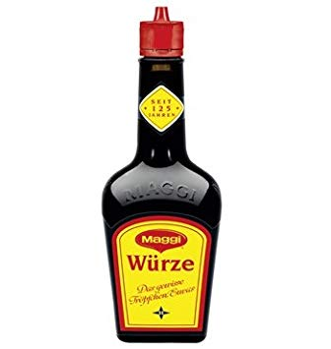
Source of the week

Slide 38
Write down 3 questions you have about this source.
“You very often bought things you did not need. But with those things in hand you could start to barter. You went round and exchanged a pair of shoes for a shirt, or a pair of socks for a sack of potatoes. And this process was repeated until you eventually ended up with things you actually wanted.”

Slide 39
A German man who was a student at the time of the Great Inflation
“You very often bought things you did not need. But with those things in hand you could start to barter. You went round and exchanged a pair of shoes for a shirt, or a pair of socks for a sack of potatoes. And this process was repeated until you eventually ended up with things you actually wanted.”

Slide 40
Fun Trivia Quiz
http://www.funtrivia.com/playquiz/quiz21347818718d8.html

Slide 41
Essay questions
Choose one of the questions above and plan an essay you could write in response to it.
To what extent did extremist political groups contribute to political unrest and instability in early 1920s Germany?
What events or factors led to the Kapp putsch of 1920? How was this putsch eventually defeated?
Was Germany’s failure to make reparations payments in 1921-22 the result of financial inability, political defiance, or both?
Why did foreign troops occupy the Ruhr in early 1923 and how did the German government, press and people respond to this?
How did the Weimar government contribute to the hyperinflation crisis of late 1923? How was this crisis eventually resolved?
Which groups or classes were most affected by the hyperinflation of 1923? Did anyone benefit from hyperinflation?

